Slide 1
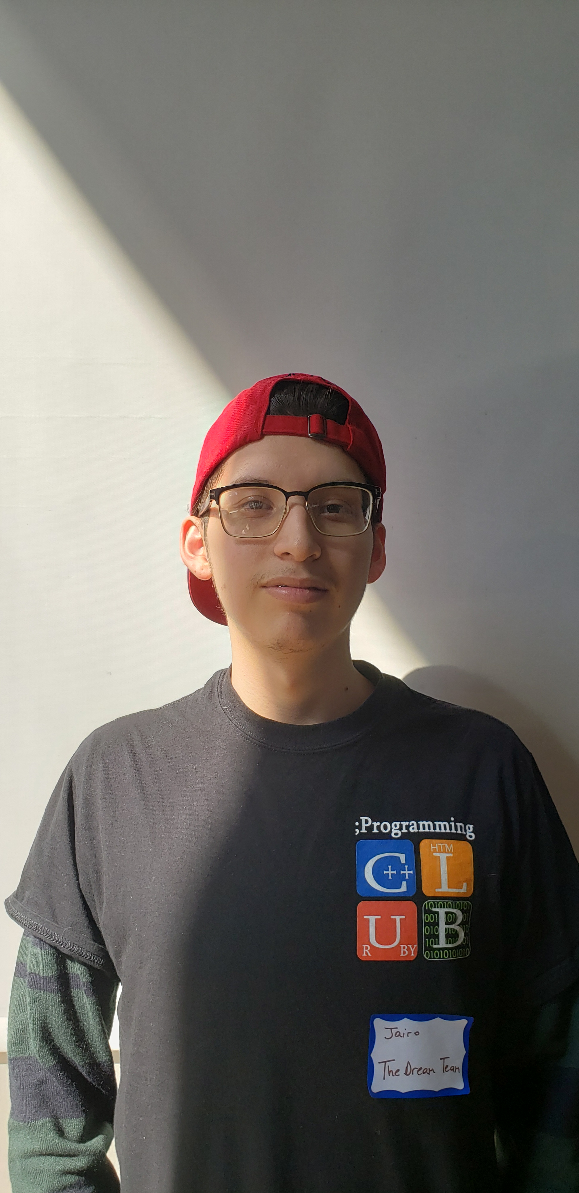
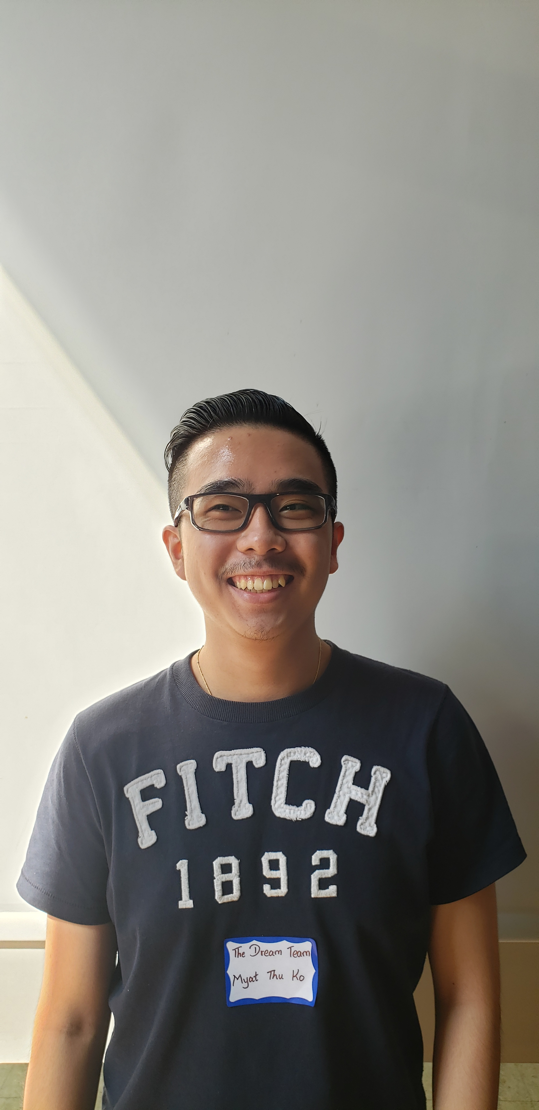
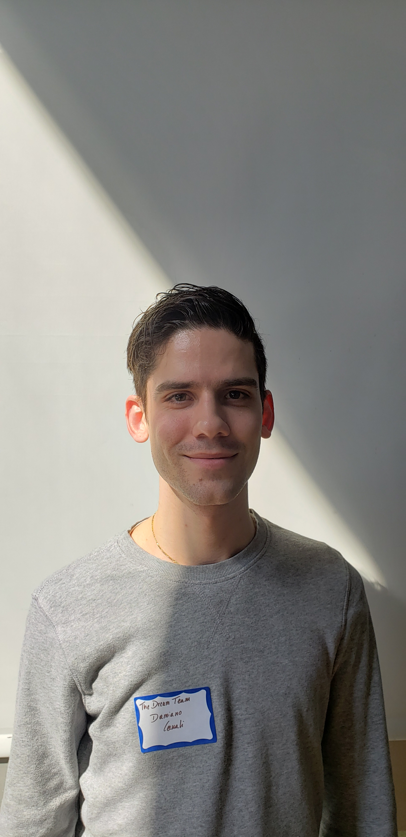
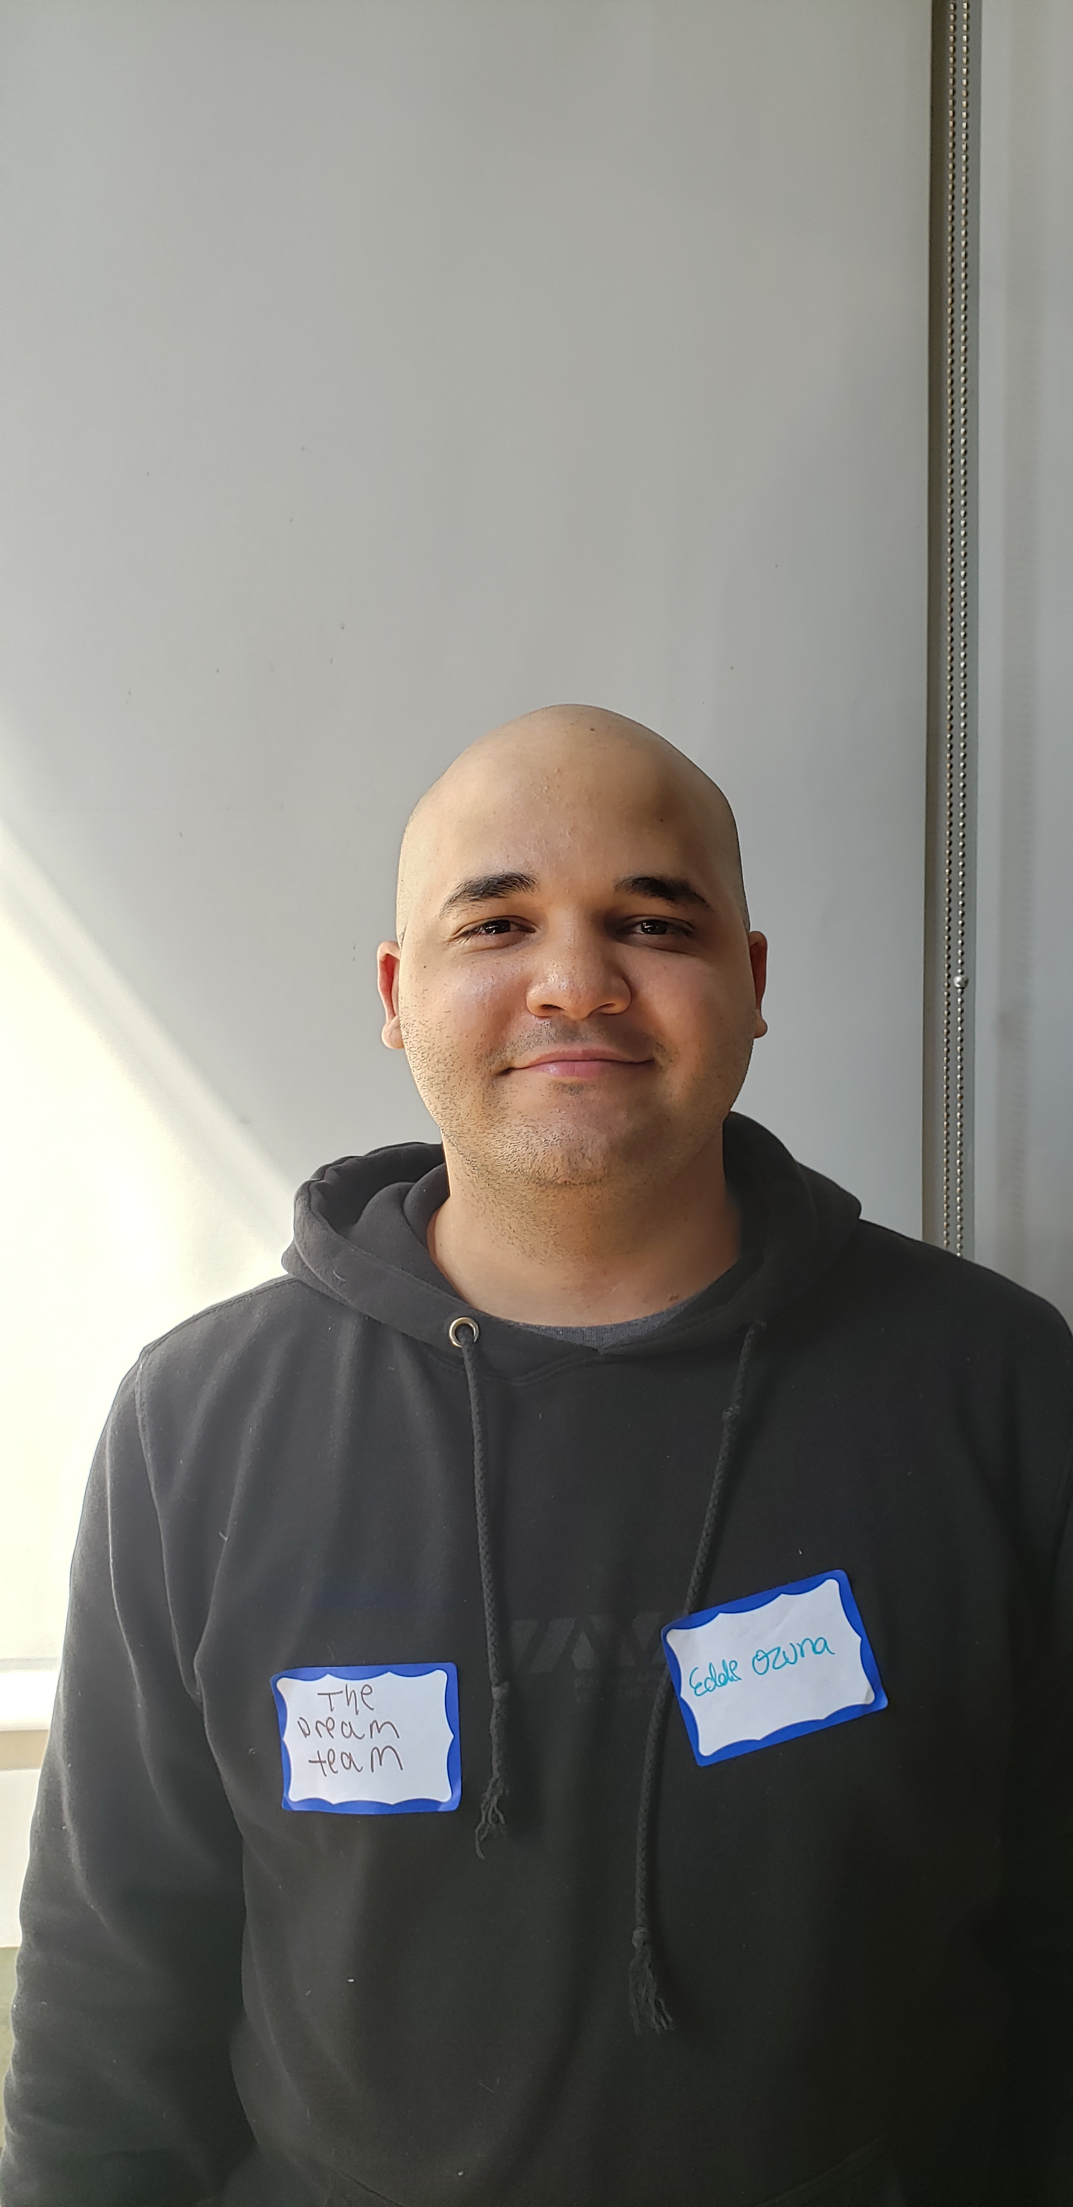
Molina Jairo, Spain
Ko Myat Thu, Myanmar
Ozuna Eddie, Dominican Republic
Canali Damiano, Italy

